Slide 1


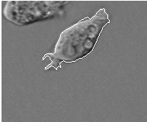
Biomedical Laboratory – 4th Year
Part : one
Image Processing Using MATLAB
Lab. No.“1”
Detecting a Cell Using Image Segmentation

Slide 2
Introduction
An object can be easily detected in an image if the object has sufficient contrast from the background of the image.
Introduction
Application:
Edge detection and basic morphology tools are used to detect a prostate cancer cell.
Procedural steps:
Step 1: Read and Display the Image
Step 2: Detect Entire Cell
Step 3: Dilate the Image
Step 4: Fill Interior Gaps
Step 5: Remove Connected Objects on Border
Step 6: Smoothen the Object
Step 7: Outline Creation
Notes:
Analytical model is derived based on governing physical laws for the system such as Newton's law, Ohms law, etc.
Experimental model is derived based on experimental empirical results and samples for the system.
Numerical values of the model parameters are often approximated from experimental data by curve fitting.
Discrimination learning models are drived

Slide 3
Step 1: Read and Display The Image
1.1 Key Commands:
I = imread('filename.fmt') :reads a grayscale or color image specified by filename and format fmt and stores it into array variable I. If the file is not in the current folder, or in a folder on the MATLAB path, specify the full pathname as:
I = imread(‘D:\pictures\asd.jpg’)
Read The Image
figure :creates a new figure object using default property values, and automatically becomes the current figure until a new figure is either created or called.
imshow(I) :displays the stored image of the variable array I.
title('string') :adds the title specified by ‘string’ at the top and in the center of the current axes or figure.
Notes:
Analytical model is derived based on governing physical laws for the system such as Newton's law, Ohms law, etc.
Experimental model is derived based on experimental empirical results and samples for the system.
Numerical values of the model parameters are often approximated from experimental data by curve fitting.
Discrimination learning models are drived

Slide 4
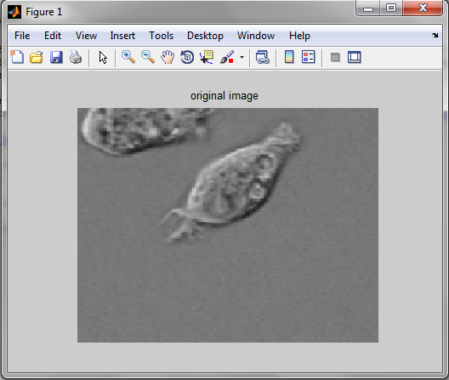
Step 1: Read and Display The Image
1.2 Step application:
Read in the 'cell.tif' image, which is an image of a prostate cancer cell.
Read The Image
I = imread('cell.tif');
figure, imshow(I), title('original image');
Notes:
Analytical model is derived based on governing physical laws for the system such as Newton's law, Ohms law, etc.
Experimental model is derived based on experimental empirical results and samples for the system.
Numerical values of the model parameters are often approximated from experimental data by curve fitting.
Discrimination learning models are drived

Slide 5
Step 2: Detect Entire Cell
2.1 Preface:
Two cells are present in that image, but only one cell can be seen in its entirety. We will detect this cell.
Another word for object detection is segmentation.
The object to be segmented differs greatly in contrast from the background image.
Changes in contrast can be detected by operators that calculate the gradient of an image.
The gradient image can be calculated and a threshold can be applied to create a binary mask containing the segmented cell.
First, we use edge and the Sobel operator to calculate the threshold value. We then tune the threshold value and use edge again to obtain a binary mask that contains the segmented cell.
Detect Entire Cell
Notes:
Analytical model is derived based on governing physical laws for the system such as Newton's law, Ohms law, etc.
Experimental model is derived based on experimental empirical results and samples for the system.
Numerical values of the model parameters are often approximated from experimental data by curve fitting.
Discrimination learning models are drived

Slide 6
Step 2: Detect Entire Cell
2.2 Key Commands:
[BW threshold]= edge(I,'sobel') :returns threshold value for the Sobel method.
BW = edge(I,'sobel',threshold*factor) :specifies the sensitivity threshold for the Sobel method. edge ignores all edges that are not stronger than threshold*factor. If you do not specify threshold*factor, or it is empty ([]), edge chooses the value automatically.
Detect Entire Cell
Hint:
That can be replaced by:
BW = edge(I,'sobel',(graythresh(I)*0.5));
Question:
What are the other methods supported by edge function?
Notes:
Analytical model is derived based on governing physical laws for the system such as Newton's law, Ohms law, etc.
Experimental model is derived based on experimental empirical results and samples for the system.
Numerical values of the model parameters are often approximated from experimental data by curve fitting.
Discrimination learning models are drived

Slide 7
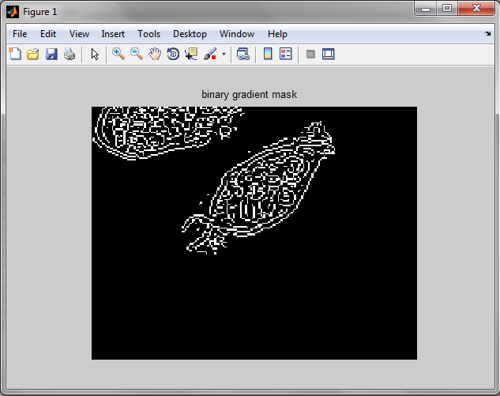
Step 2: Detect Entire Cell
2.3 Step application:
[BW threshold] = edge(I, 'sobel');
Factor = 0.1;
BWs = edge(I,'sobel', threshold * Factor);
figure,imshow(BWs),title('binary gradient mask');
Detect Entire Cell
Notes:
Analytical model is derived based on governing physical laws for the system such as Newton's law, Ohms law, etc.
Experimental model is derived based on experimental empirical results and samples for the system.
Numerical values of the model parameters are often approximated from experimental data by curve fitting.
Discrimination learning models are drived

Slide 8
Step 3: Dilate the Image
3.1 Preface:
The binary gradient mask shows lines of high contrast in the image. These lines do not quite delineate the outline of the object of interest.
Compared to the original image, you can see gaps in the lines surrounding the object in the gradient mask.
These linear gaps will disappear if the Sobel image is dilated using linear structuring elements, which we can create with the strel function.
Dilate the Image
3.2 Key Commands:
BWsdil = imdilate(BWs,SE) :dilates the grayscale, binary image BWs to the dilated image BWsdil. The argument SE is a structuring element object, or array of structuring element objects, returned by the strel function.
Notes:
Analytical model is derived based on governing physical laws for the system such as Newton's law, Ohms law, etc.
Experimental model is derived based on experimental empirical results and samples for the system.
Numerical values of the model parameters are often approximated from experimental data by curve fitting.
Discrimination learning models are drived

Slide 9
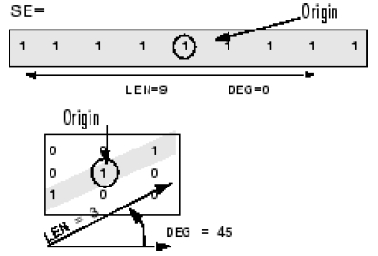
Step 3: Dilate the Image
SE = strel(shape, parameters) :creates a structuring element, SE, of the type specified by shape as ‘line’, ‘square’, ‘diamond’, ‘disk’, ‘octagon’, ‘rectangle’, …etc. Depending on shape, strel can take additional parameters as:
SE = strel('line', LEN, DEG) creates a flat symmetric linear structuring element. DEG is the angle (in degrees) in a counterclockwise direction from the horizontal axis. LEN is the length of the line.
Dilate the Image
Notes:
Analytical model is derived based on governing physical laws for the system such as Newton's law, Ohms law, etc.
Experimental model is derived based on experimental empirical results and samples for the system.
Numerical values of the model parameters are often approximated from experimental data by curve fitting.
Discrimination learning models are drived

Slide 10
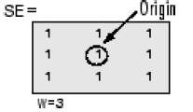
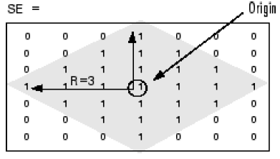
Step 3: Dilate the Image
SE = strel('square', W) :creates a square structuring element whose width is W pixels. W must be a nonnegative integer scalar.
Dilate the Image
SE = strel('diamond', R) :creates a diamond-shaped structuring element, where R specifies the distance from the origin to the points of the diamond. R must be a nonnegative integer scalar.
Notes:
Analytical model is derived based on governing physical laws for the system such as Newton's law, Ohms law, etc.
Experimental model is derived based on experimental empirical results and samples for the system.
Numerical values of the model parameters are often approximated from experimental data by curve fitting.
Discrimination learning models are drived

Slide 11
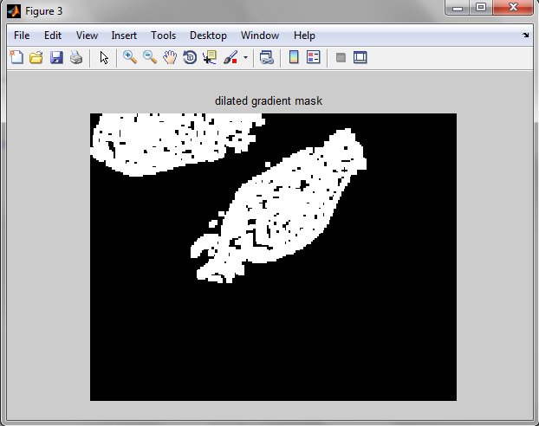
Step 3: Dilate the Image
3.3 Step application:
The binary gradient mask is dilated using vertical structuring element followed by horizontal structuring element:
se90 = strel('line', 3, 90);
se0 = strel('line', 3, 0);
BWsdil = imdilate(BWs, [se90 se0]);
figure, imshow(BWsdil);
title('dilated gradient mask');
Dilate the Image
Notes:
Analytical model is derived based on governing physical laws for the system such as Newton's law, Ohms law, etc.
Experimental model is derived based on experimental empirical results and samples for the system.
Numerical values of the model parameters are often approximated from experimental data by curve fitting.
Discrimination learning models are drived

Slide 12
Step 4: Fill Interior Gaps
4.1 Preface:
The dilated gradient mask shows the outline of the cell quite nicely, but there are still holes in the interior of the cell. To fill these holes we use the imfill function.
4.2 Key Commands:
Fill Interior Gaps
BWdfill = imfill(BWsdil,'holes') :fills holes in the binary image BWsdil. A hole is a set of background pixels that cannot be reached by filling in the background from the edge of the image.
Hint:
'holes': are defined as an area of dark pixels (Black) surrounded by lighter pixels (White).
Notes:
Analytical model is derived based on governing physical laws for the system such as Newton's law, Ohms law, etc.
Experimental model is derived based on experimental empirical results and samples for the system.
Numerical values of the model parameters are often approximated from experimental data by curve fitting.
Discrimination learning models are drived

Slide 13
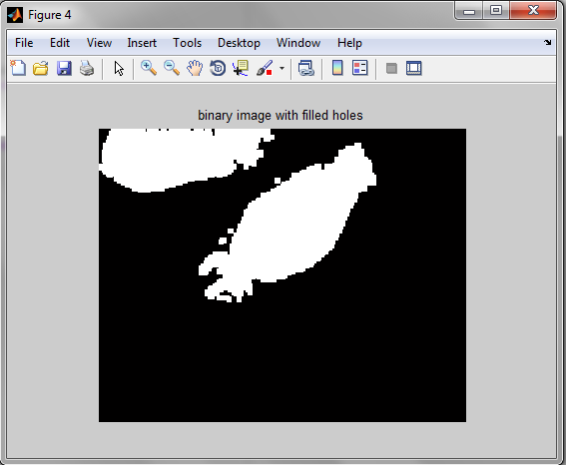
Step 4: Fill Interior Gaps
4.3 Step application:
BWdfill = imfill(BWsdil, 'holes');
figure, imshow(BWdfill);
title('binary image with filled holes');
Fill Interior Gaps
Notes:
Analytical model is derived based on governing physical laws for the system such as Newton's law, Ohms law, etc.
Experimental model is derived based on experimental empirical results and samples for the system.
Numerical values of the model parameters are often approximated from experimental data by curve fitting.
Discrimination learning models are drived

Slide 14
Step 5: Remove Connected Objects on Border
5.1 Preface:
The cell of interest has been successfully segmented, but it is not the only object that has been found.
Any objects that are connected to the border of the image can be removed using the imclearborder function.
The connectivity in the imclearborder function was set to 4 to remove diagonal connections.
Remove Connected Ojects on Border
5.2 Key Commands:
Bwnobord = imclearborder(BWdfill,conn) :suppresses structures that are lighter than their surroundings and connected to the image border (clear the image border) with the desired connectivity conn. The connectivity may be 4 or 8 for two dimensions.
Notes:
Analytical model is derived based on governing physical laws for the system such as Newton's law, Ohms law, etc.
Experimental model is derived based on experimental empirical results and samples for the system.
Numerical values of the model parameters are often approximated from experimental data by curve fitting.
Discrimination learning models are drived

Slide 15
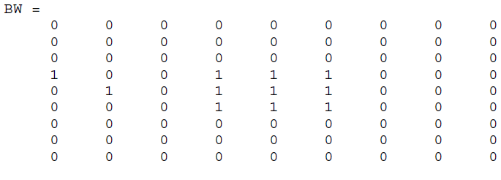
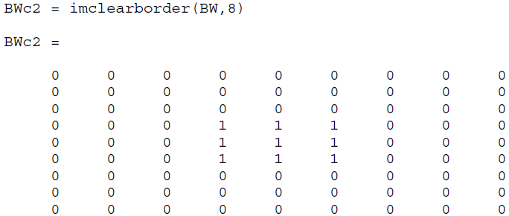
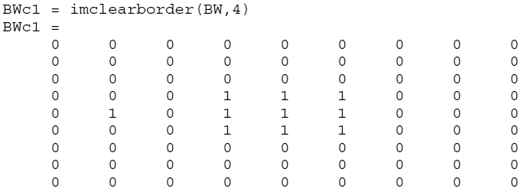
Step 5: Remove Connected Objects on Border
connectivity of white pixels = 4
connectivity of white pixels = 8
Remove Connected Ojects on Border
Notes:
Analytical model is derived based on governing physical laws for the system such as Newton's law, Ohms law, etc.
Experimental model is derived based on experimental empirical results and samples for the system.
Numerical values of the model parameters are often approximated from experimental data by curve fitting.
Discrimination learning models are drived

Slide 16
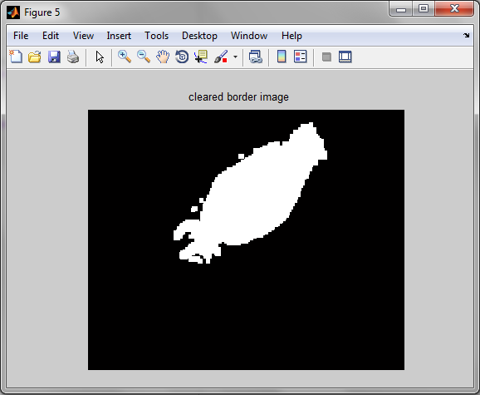
Step 5: Remove Connected Objects on Border
5.3 Step application:
BWnobord = imclearborder(BWdfill, 4);
figure, imshow(BWnobord);
title('cleared border image');
Remove Connected Ojects on Border
Notes:
Analytical model is derived based on governing physical laws for the system such as Newton's law, Ohms law, etc.
Experimental model is derived based on experimental empirical results and samples for the system.
Numerical values of the model parameters are often approximated from experimental data by curve fitting.
Discrimination learning models are drived

Slide 17
Step 6: Smoothen the Object
6.1 Preface:
In order to make the segmented object look natural, we smoothen the object by eroding the image twice with a diamond structuring element. We create the diamond structuring element using the strel function.
6.2 Key Commands:
BWfinal = imerode(BWnobord,SE) :erodes the grayscale binary image BWnobord, returning the eroded image BWfinal. The argument SE is a structuring element object or array of structuring element objects returned by the strel function.
Smoothen the Oject
Eroding process to smoothen the objected is required as consequences of dilation process of the object.
Notes:
Analytical model is derived based on governing physical laws for the system such as Newton's law, Ohms law, etc.
Experimental model is derived based on experimental empirical results and samples for the system.
Numerical values of the model parameters are often approximated from experimental data by curve fitting.
Discrimination learning models are drived

Slide 18
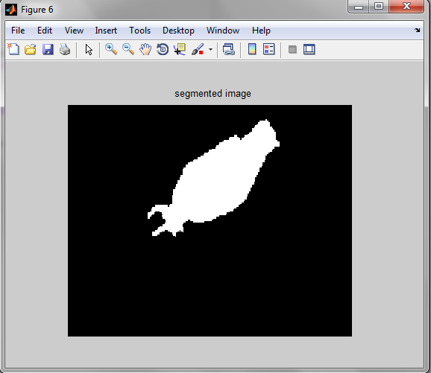
Step 6: Smoothen the Object
6.3 Step application:
seD = strel('diamond',1);
BWfinal = imerode(BWnobord,seD);
BWfinal = imerode(BWfinal,seD);
figure, imshow(BWfinal);
title('segmented image');
Smoothen the Oject
Notes:
Analytical model is derived based on governing physical laws for the system such as Newton's law, Ohms law, etc.
Experimental model is derived based on experimental empirical results and samples for the system.
Numerical values of the model parameters are often approximated from experimental data by curve fitting.
Discrimination learning models are drived

Slide 19
Step 7: Outline Creation
7.1 Preface:
Finally, the method of displaying the segmented object would be to place an outline around the segmented cell. The outline is created by the bwperim function.
7.2 Key Commands:
BWoutline = bwperim(BWfinal) :returns a binary image containing only the perimeter pixels of objects in the input image BWfinal. A pixel is part of the perimeter if it is nonzero and it is connected to at least one zero-valued pixel.
Outline is created on a copy of the original intensity image depending on the perimeter pixels of object with lighten pixels (white = 255)
Outline Creation
Notes:
Analytical model is derived based on governing physical laws for the system such as Newton's law, Ohms law, etc.
Experimental model is derived based on experimental empirical results and samples for the system.
Numerical values of the model parameters are often approximated from experimental data by curve fitting.
Discrimination learning models are drived

Slide 20
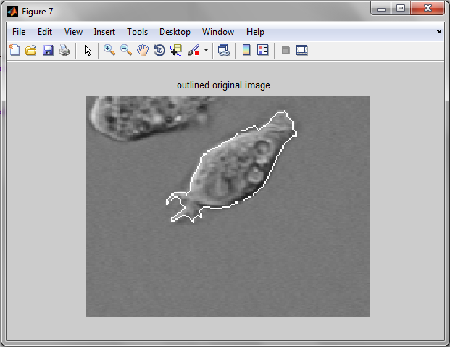
Step 7: Outline Creation
7.3 Step application:
BWoutline = bwperim(BWfinal);
Segout = I;
Segout(BWoutline) = 255;
figure, imshow(Segout);
title('outlined original image');
Outline Creation
Notes:
Analytical model is derived based on governing physical laws for the system such as Newton's law, Ohms law, etc.
Experimental model is derived based on experimental empirical results and samples for the system.
Numerical values of the model parameters are often approximated from experimental data by curve fitting.
Discrimination learning models are drived

Slide 21


Questions and Discussion
Questions and Discussion

